Slide 1
Deep Learning
in
Recommendation System
统计学院：韩翠云

Slide 2
Main Contents
Recommendation System
Deep Learning
DCF：deep collaborative filtering

Slide 3
Recommendation System
What？
—youtube、Amazon、网易云音乐
Why？—information overload、Long tail
How？
—content filering、collaborative filtering

Slide 4
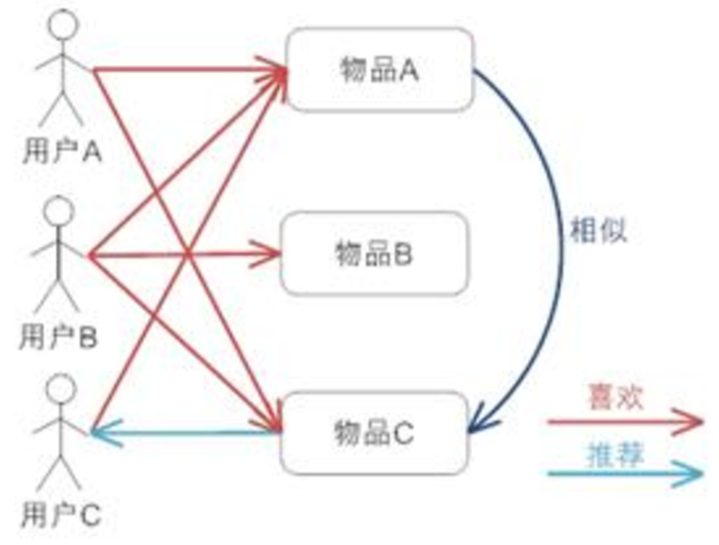
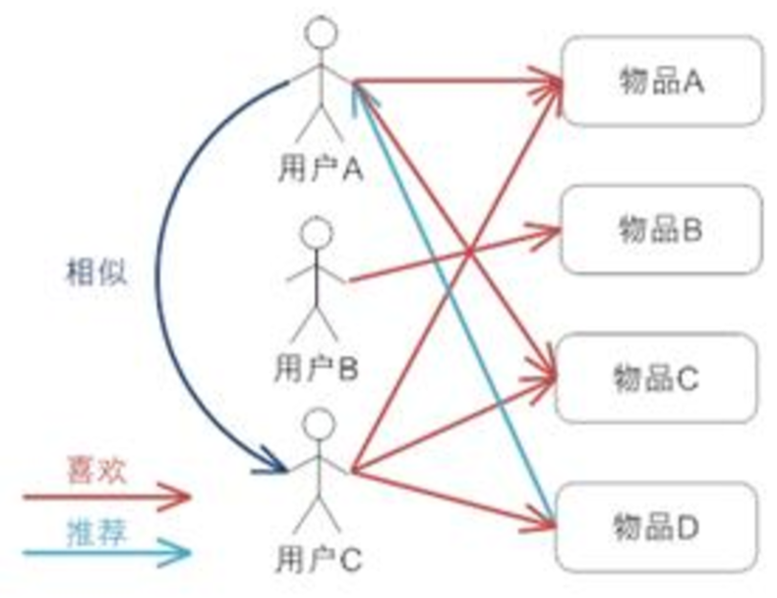
Collaborative Filtering
User-Base
Item-Base
Model-Base

Slide 5
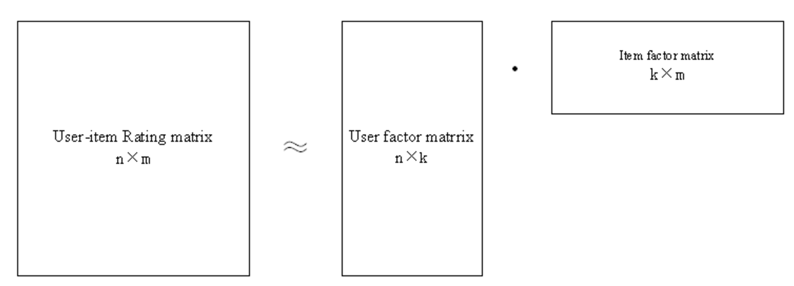
Matrix Factorization
R~UV
R为打分矩阵
U为user对latent factor的偏好程度
V表示每个item对latent factor上的表现程度

Slide 6

Matrix Factorization
目标函数:
$min\sum_{i=1}^{M}{\sum_{j=1}^{N}{{\left(R_{ij}−U_{i}^{T}V_{j}\right)}^{2}}}$
优化方法：
ALS：交替迭代最小二乘
SGD：随机梯度下降
改进：RMF、PMF

Slide 7

Matrix Factorization
稀疏-> 加正则防止过拟合:RMF
$min\sum_{i=1}^{M}{\sum_{j=1}^{N}{{\left(R_{ij}−U_{i}^{T}V_{j}\right)}^{2}+λ_{1}{\left\|U_{i}\right\|}^{2}+λ_{2}{\left\|V_{j}\right\|}^{2}}}$
非负矩阵分解：NMF
$min\sum_{i=1}^{M}{\sum_{j=1}^{N}{{\left(R_{ij}−U_{i}^{T}V_{j}\right)}^{2}}}, st U>0,V>0$

Slide 8

PMF
User/Item-latent-factor Gaussian prior
$P\left(U|σ_{u}^{2}\right)=\prod_{i=1}^{M}{N\left(U_{i}|0,σ_{u}^{2}\right)}$; $P\left(V|σ_{v}^{2}\right)=\prod_{j=1}^{N}{N\left(V_{j}|0,σ_{v}^{2}\right)}$
Rating conditional prob is Gaussian
$P\left(R|U,V,σ^{2}\right)=\prod_{i=1}^{M}{\prod_{j=1}^{N}{N{\left(R_{ij}|U_{i}^{T}V_{j},σ^{2}\right)}^{I_{ij}}}}$
U,V is independent; bayes formula
$P\left(U,V|R,σ^{2},σ_{u}^{2},σ_{v}^{2}\right)=P\left(R|U,V,σ^{2}\right)P\left(U|σ_{u}^{2}\right)P\left(V|σ_{v}^{2}\right)$
$$=\prod_{i=1}^{M}{\prod_{j=1}^{N}{N{\left(R_{ij}|U_{i}^{T}V_{j},σ^{2}\right)}^{I_{ij}}}}\prod_{i=1}^{M}{N\left(U_{i}|0,σ_{u}^{2}\right)}\prod_{j=1}^{N}{N\left(V_{j}|0,σ_{v}^{2}\right)}$$

Slide 9

PMF
likelihood function:
$ln P\left(U,V|R,σ^{2},σ_{U}^{2},σ_{V}^{2}\right)=−\frac{1}{2σ^{2}}\sum_{i=1}^{M}{\sum_{j=1}^{N}{I_{ij}{\left(R_{ij}−U_{i}^{T}V_{i}\right)}^{2}}}$
$$−\frac{1}{2σ_{U}^{2}}\sum_{i=1}^{M}{U_{i}^{T}U_{i}}−\frac{1}{2σ_{V}^{2}}\sum_{j=1}^{N}{V_{j}^{T}V_{j}}−\frac{1}{2}\left(\left(\sum_{i=1}^{M}{\sum_{j=1}^{N}{I_{ij}}}\right)lnσ^{2}+MDlnσ_{U}^{2}+NDlnσ_{V}^{2}\right)+C$$

Slide 10

PMF
max likelihood function 等价于 min L
$L=\sum_{i=1}^{M}{\sum_{j=1}^{N}{I_{ij}{\left(R_{ij}−U_{i}^{T}V_{i}\right)}^{2}}}+λ_{U}\sum_{i=1}^{M}{U_{i}^{T}U_{i}}+λ_{V}\sum_{j=1}^{N}{V_{j}^{T}V_{j}}$
$$=\sum_{i=1}^{M}{\sum_{j=1}^{N}{I_{ij}{\left(R_{ij}−U_{i}^{T}V_{i}\right)}^{2}}+}λ_{U}{\left\|U\right\|}_{F}^{2}+λ_{V}{\left\|V\right\|}_{F}^{2}$$
$L={\left\|I⨀\left(R−UV^{T}\right)\right\|}_{F}^{2}+λ_{U}{\left\|U\right\|}_{F}^{2}+λ_{V}{\left\|V\right\|}_{F}^{2}$

Slide 11
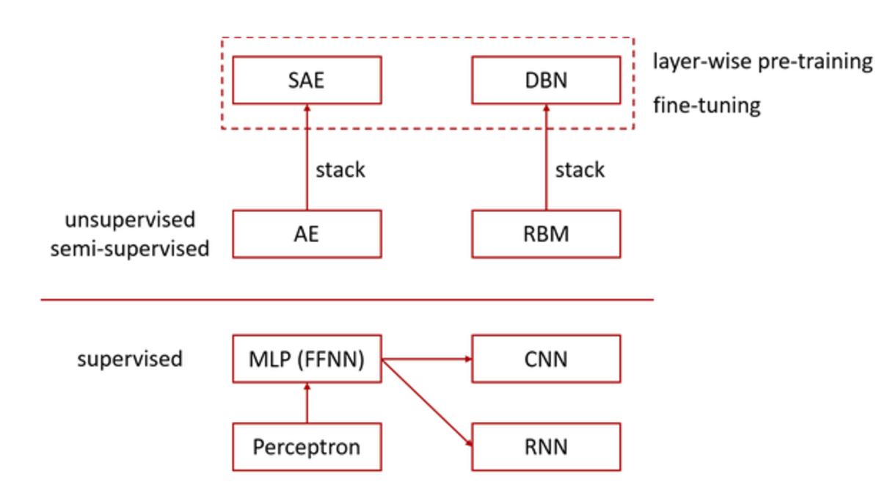
Deep Learning

Slide 12
Deep Learning
CNN：convolutional neural network
convolutional layer
subsampling layer
all connection layer

Slide 13
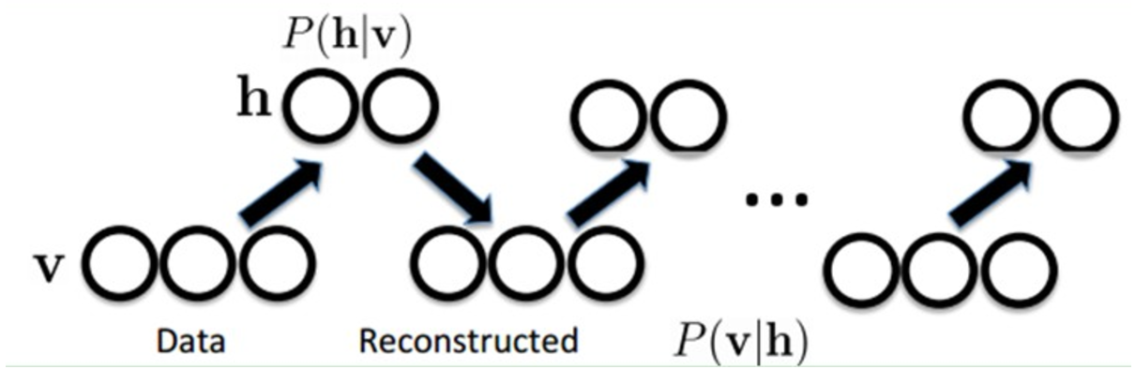
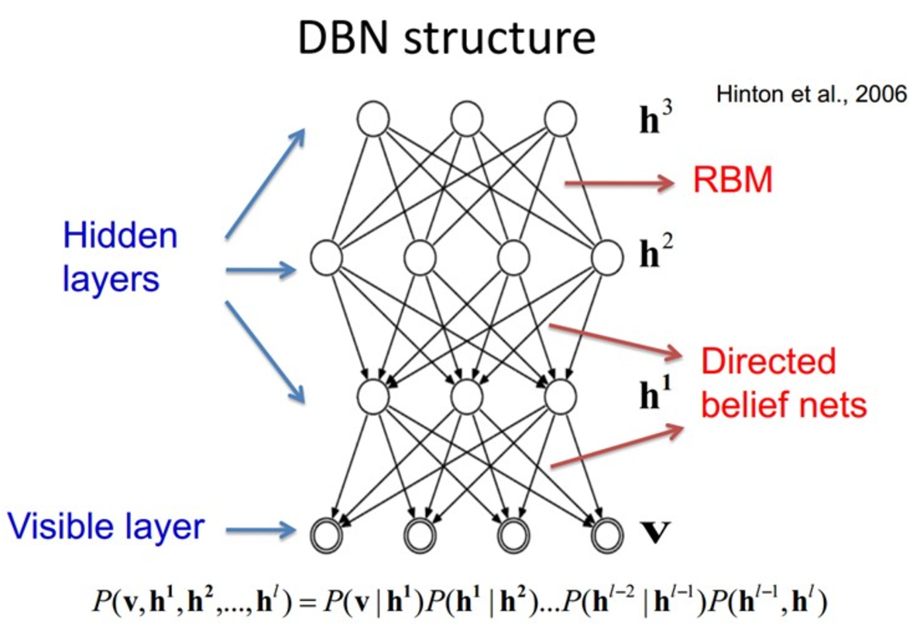
Deep Learning
DBN：deep belief network
RBM
pre-training
fine-tune

Slide 14
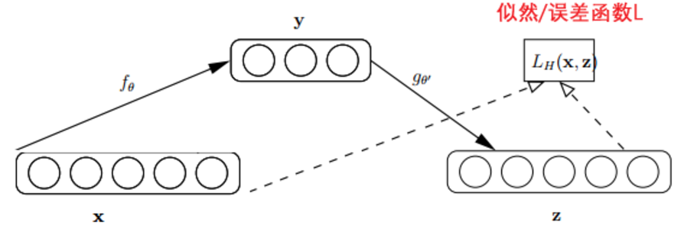
Deep Learning
SAE：stack auto-encoder
layer-wise unsuperwised pre-training
autoencoder

Slide 15
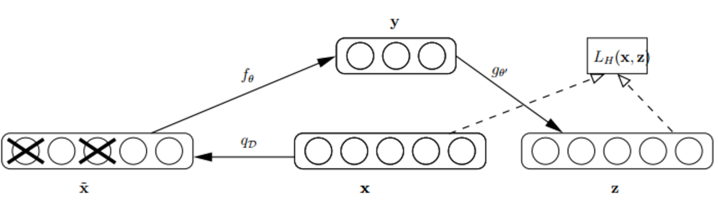

AutoEncoder
denoising autoencoder
$L\left(W\right)=\frac{1}{2ck}\sum_{j=1}^{c}{\sum_{i=1}^{k}{{\left\|x_{i}−W{\tilde{x}}_{ij}\right\|}^{2}}}$
$L\left(W\right)={\left\|\overline{X}−W\tilde{X}\right\|}_{F}^{2}$ $\overline{X}=\left(X_{1},X_{2},⋯,X_{c}\right)$
$W=PQ^{−1}$ $Q=\tilde{X}{\tilde{X}}^{T}$ $P=\overline{X}{\tilde{X}}^{T}$

Slide 16

AutoEncoder
marginalized denoising auto-encode: mDA
$W=E\left(P\right)E({Q)}^{−1}$
$E{\left(Q\right)}_{αβ}=\left\{\begin{aligned}S_{αβ}q_{α}q_{β} if α≠β \\ S_{αβ}q_{α} ifα=β\end{aligned}\right.$
$E{\left(P\right)}_{αβ}=S_{αβ}q_{β}$
$q={\left[1−p,⋯,1−p,1\right]}^{T}∈R^{d+1}$

Slide 17

mSDA
Marginalized stack denoising auto-encode
layer-wise unsuperwised pre-training
a non-linear “squashing” function :
$h^{t}=\tanh\left(W^{t}h^{t−1}\right)$
$h^{0}=X$

Slide 18
DCF
传统的CF存在问题：
cold start
sparse
DL在学习有效特征表示方面效果显著
结合CF和DL

Slide 19

DCF
$$argmin_{U,V}l\left(R,U,V\right)+β\left({\left\|U\right\|}_{F}^{2}+{\left\|V\right\|}_{F}^{2}\right)+γL\left(X,U\right)+δL(Y,V)$$
R：打分矩阵
U：用户偏好矩阵
V：项目偏好矩阵
X：用户的side information
Y：项目的side information
$β、γ、δ$为超参数

Slide 20
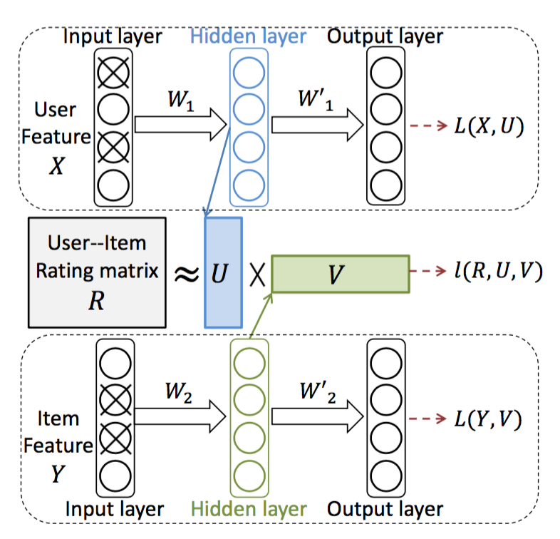
DCF
$$argmin_{U,V}l\left(R,U,V\right)+β\left({\left\|U\right\|}_{F}^{2}+{\left\|V\right\|}_{F}^{2}\right)+γL\left(X,U\right)+δL(Y,V)$$

Slide 21
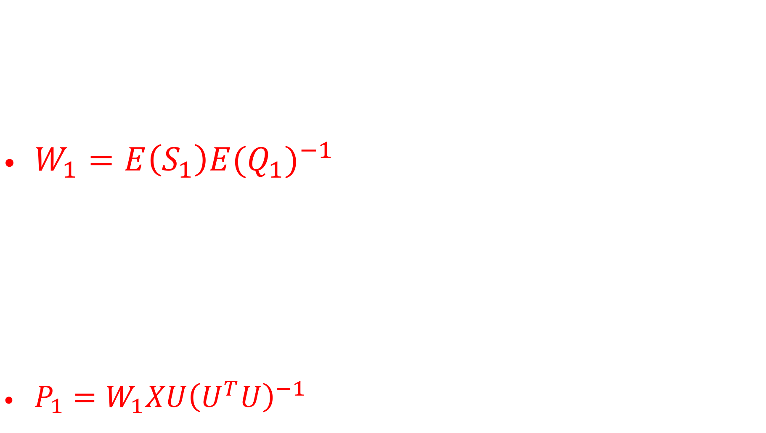
mDA-CF
$argmin_{W_{1}}{\left\|\overline{X}−W_{1}\tilde{X}\right\|}_{F}^{2}+λ{\left\|P_{1}U−W_{1}X\right\|}_{F}^{2}$
$W_{1}=E\left(S_{1}\right)E({Q_{1})}^{−1}$
$S_{1}=\overline{X}{\tilde{X}}^{T}+λP_{1}U^{T}X^{T}$ $Q_{1}=\tilde{X}{\tilde{X}}^{T}+λXX^{T}$
$argmin_{p_{1}}λ{\left\|P_{1}U−W_{1}X\right\|}_{F}^{2}$
$P_{1}=W_{1}XU{\left(U^{T}U\right)}^{−1}$

Slide 22
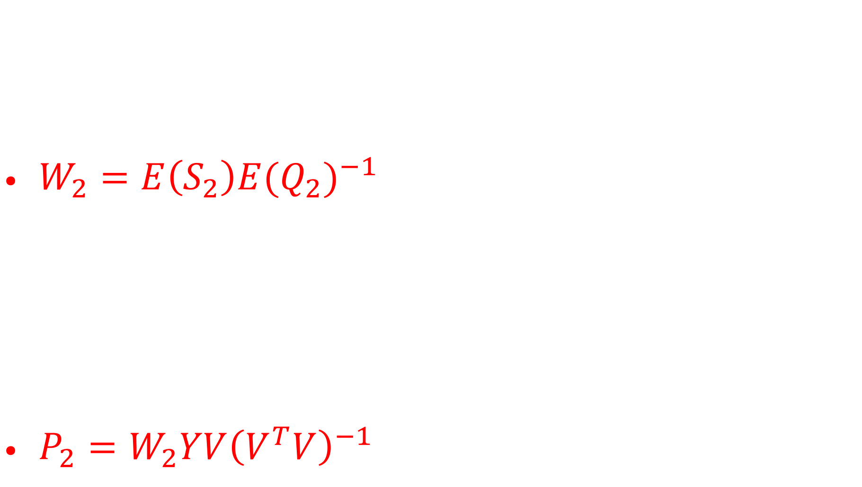
mDA-CF
$argmin_{W_{2}}{\left\|\overline{Y}−W_{2}\tilde{Y}\right\|}_{F}^{2}+λ{\left\|P_{2}V−W_{2}Y\right\|}_{F}^{2}$
$W_{2}=E\left(S_{2}\right)E({Q_{2})}^{−1}$
$S_{2}=\overline{Y}{\tilde{Y}}^{T}+λP_{2}U^{T}Y^{T}$ $Q_{2}=\tilde{Y}{\tilde{Y}}^{T}+λYY^{T}$
$argmin_{P_{2}}λ{\left\|P_{2}V−W_{2}Y\right\|}_{F}^{2}$
$P_{2}=W_{2}YV{\left(V^{T}V\right)}^{−1}$

Slide 23

PMF+mDA
$$argmin_{U,V,W_{1},W_{2},P_{1},P_{2}}$$
$$l\left(R,U,V\right)+β\left({\left\|U\right\|}_{F}^{2}+{\left\|V\right\|}_{F}^{2}\right)$$
$$+$$
$$γL_{U}\left(W_{1},P_{1}, U\right)+δL_{V}(W_{2},P_{2},V)$$
where
$$l\left(R,U,V\right)={\left\|I⨀\left(R−UV^{T}\right)\right\|}_{F}^{2}$$
$$L_{U}\left(W_{1},P_{1}, U\right)={\left\|\overline{X}−W_{1}\tilde{X}\right\|}_{F}^{2}+λ{\left\|P_{1}U−W_{1}X\right\|}_{F}^{2}$$
$$L_{V}\left(W_{2},P_{2}, V\right)={\left\|\overline{Y}−W_{2}\tilde{Y}\right\|}_{F}^{2}+λ{\left\|P_{2}U−W_{2}Y\right\|}_{F}^{2}$$

Slide 24
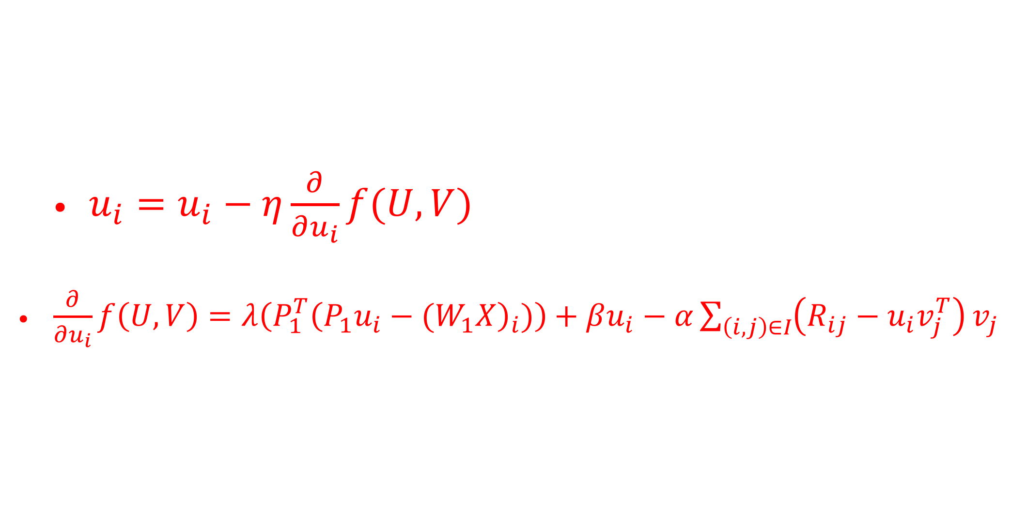
PMF+mDA
SGD
$u_{i}=u_{i}−η\frac{∂}{∂u_{i}}f(U,V)$
$\frac{∂}{∂u_{i}}f\left(U,V\right)=λ\left(P_{1}^{T}{\left(P_{1}u_{i}−(W_{1}X\right)}_{i})\right)+βu_{i}−α\sum_{\left(i,j\right)∈I}{\left(R_{ij}−u_{i}v_{j}^{T}\right)}v_{j}$

Slide 25
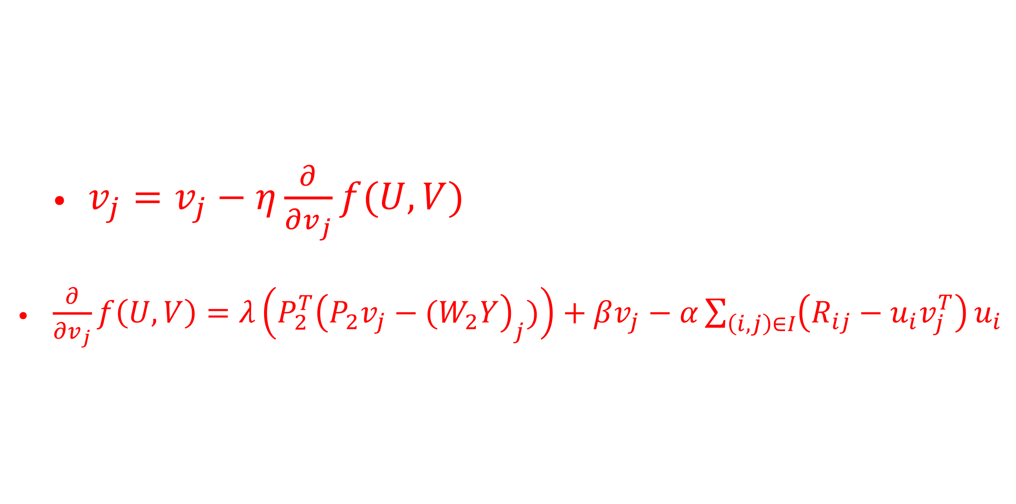
PMF+mDA
SGD
$v_{j}=v_{j}−η\frac{∂}{∂v_{j}}f(U,V)$
$\frac{∂}{∂v_{j}}f\left(U,V\right)=λ\left(P_{2}^{T}{\left(P_{2}v_{j}−(W_{2}Y\right)}_{j})\right)+βv_{j}−α\sum_{\left(i,j\right)∈I}{\left(R_{ij}−u_{i}v_{j}^{T}\right)}u_{i}$

Slide 26
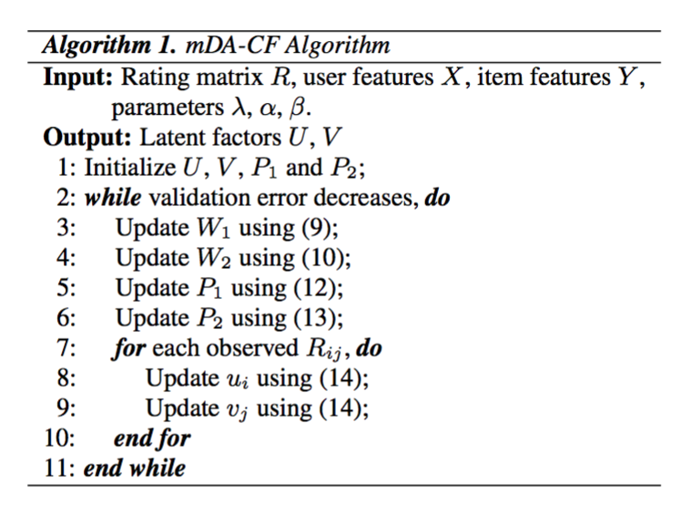
PMF+mDA

Slide 27
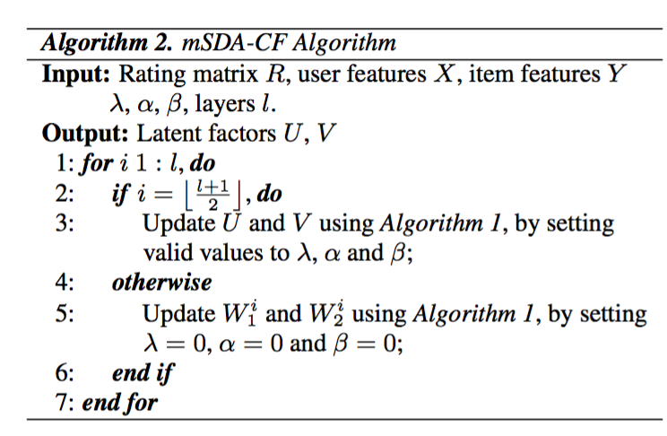
PMF+mSDA

Slide 28
WOT-京东展示广告
用户兴趣建模
推荐服务：
Item-base User-base Content-base
Item2vec、User2vec
排序：LR+DNN+LTR

Slide 29
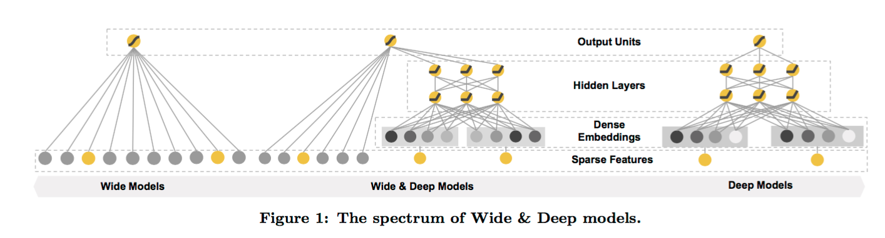
Google-W&DL

Slide 30
Google-W&DL
wide---高维特征+特征组合的LR
LR高效、scalable、可解释性强、泛化性能差
需要在特征工程上下功夫(GBDT)，交叉特征
deep--deep learning
对离散特征进行embedding + 连续特征
是传统矩阵分解的一种泛化

Slide 31
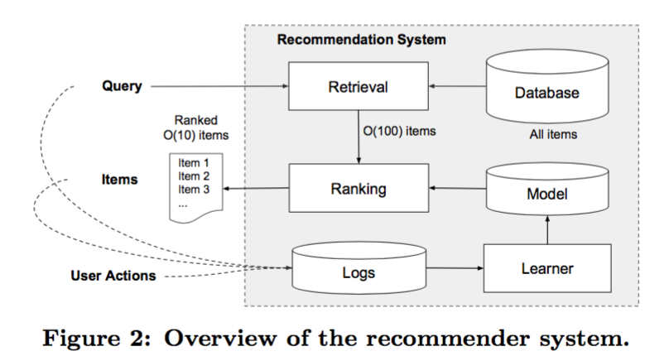
Google-RS in Google play
Google play -- app store:
with > one billion users and > one million apps

Slide 32
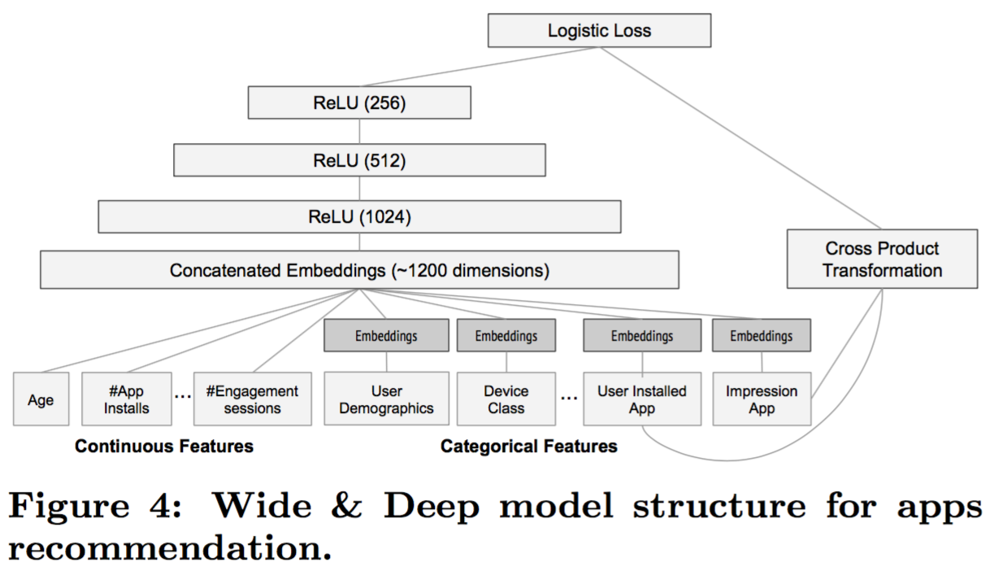


Google-RS in Google play
$$P\left(Y=1 | x\right)=σ\left(W_{wide}^{T}\left[x,φ\left(x\right)\right]+W_{deep}^{T}a^{\left(l_{f}\right)}+b\right)$$
$φ_{k}\left(x\right)=\prod_{i=1}^{d}{x_{i}^{c_{ki}}}$ $c_{ki}=\left\{0,1\right\}$
$$a^{\left(l+1\right)}=f(W^{(l)}a^{\left(l\right)}+b^{\left(l\right)})$$

Slide 33
Reference
Deep Collaborative Filtering via Marginalized Denoising Autoencoder
Probability matrix decomposition models
Extracting and composing robust features with denoising autoencoders
Marginalized Denoising Autoencoders for Domain Adaptation
Wide & Deep Learning for Recommender Systems
Deep Neural Networks for YouTube Recommendations

